Slide 1

Java PushbackReader class
PushbackReader is a character-stream reader that allows characters to be pushed back into the stream.
PushbackReader allows you to push back the read characters into the Reader. These characters will then be read again the next time you call read().
The Java PushbackReader works much like the PushbackInputStream except that the PushbackReader works on characters, whereas the PushbackInputStream works on bytes.
The PushbackReader is useful when you parse data from a Reader. Sometimes you would have the requirement to read ahead a few characters to see what is coming next, before you can determine how to interpret the current character. The PushbackReader allows that facility for the programmers.
PrintStream
Reader(i.e FileReader)
Pushback
PushbackReader
Java Application
Read
Read

Slide 2
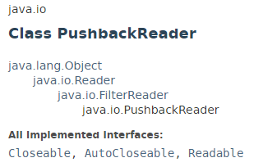
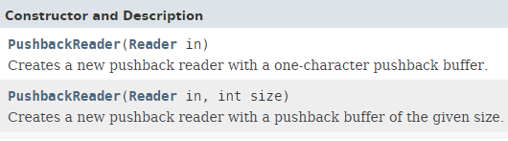
Java PushbackReader class

Slide 3
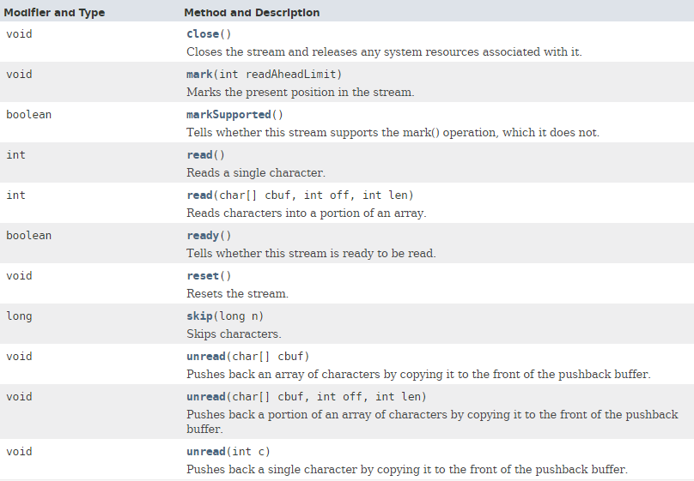
Java PushbackReader class

Slide 4
Java PushbackReader class
https://docs.oracle.com/javase/8/docs/api/index.html?java/io/PushbackReader.html

